Slide 1

Problems and Solutions / Workarounds

Slide 2
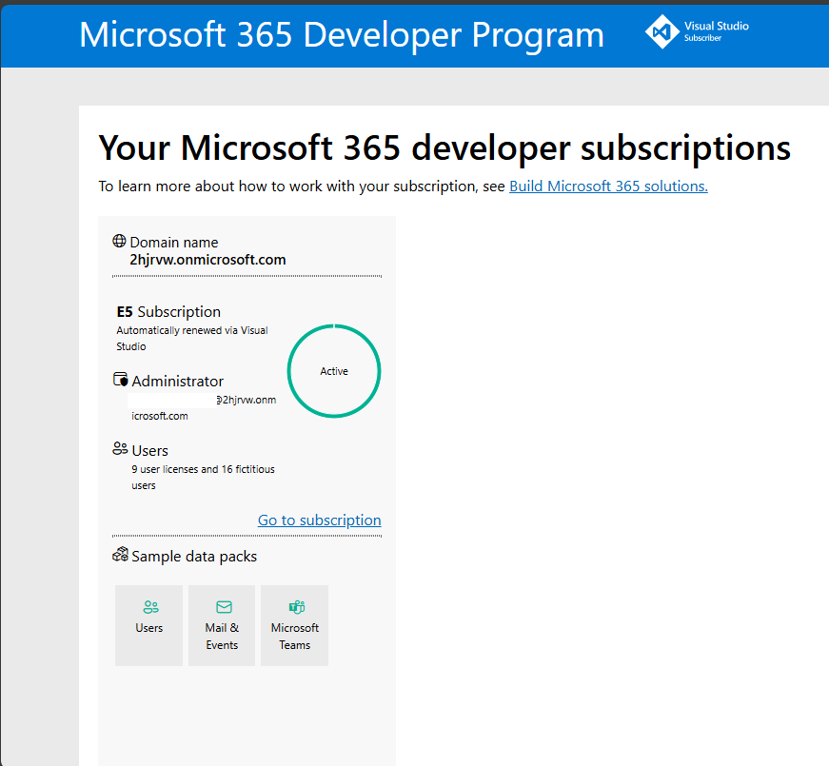
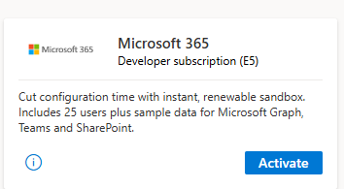
PROBLEM:
Environments /
Tenants
I have a ’DEV’ tenant.
This tenant is provisioned by using a ’Benefit’ on the a Visual Studio (Professional) Subscription Edition:

Slide 3
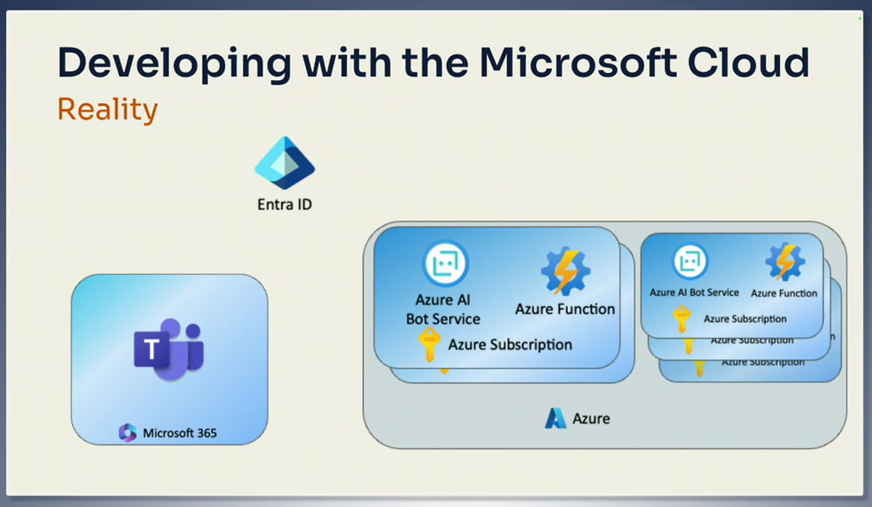
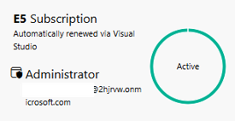
PROBLEM: Environments / Tenants
My ’DEV’ Environment had M365 + EntraID completely:
  I was abe to use and configure for example SharePoint Sites but not abel to create any Resources Groups in Azure.
My problme was, that I didn’t had any Subscription in the this Azure. My problem still persists, I still can't configure this Azure.
  What I mean under ’this Azure’ I like to provision with the Admin account of this setup a subcription.
  Or is this not technically possible?

Slide 4
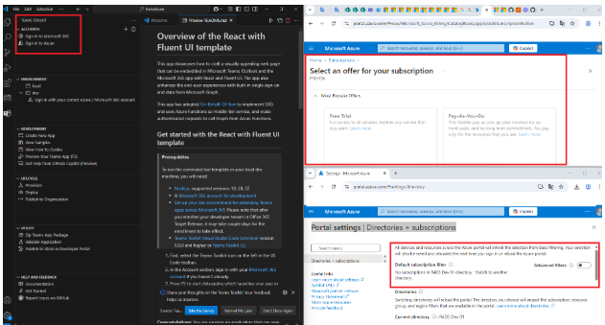
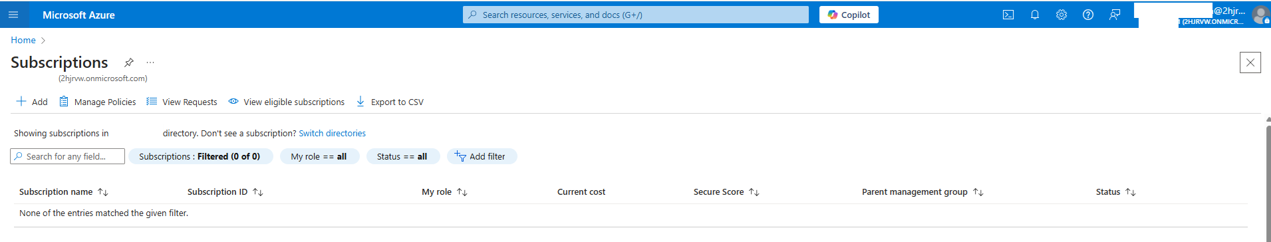
PROBLEM: Environments / Tenants
Wrong example:
Better example:
Maybe the pictures I put together were confusing (right hand side), even though I watched and read Andrew's instructions on how to properly report a bug. I figured out that reporting my problem properly is a matter of practice, because no matter how well-intentioned I was, the montage of uploaded pictures was more confusing than the solid fact that I DO NOT have a Subscription in my Azure (at the bottom of this slide). Sorry for that, I'm trying to improve,
thanks to Andrew for reading
between the lines.

Slide 5
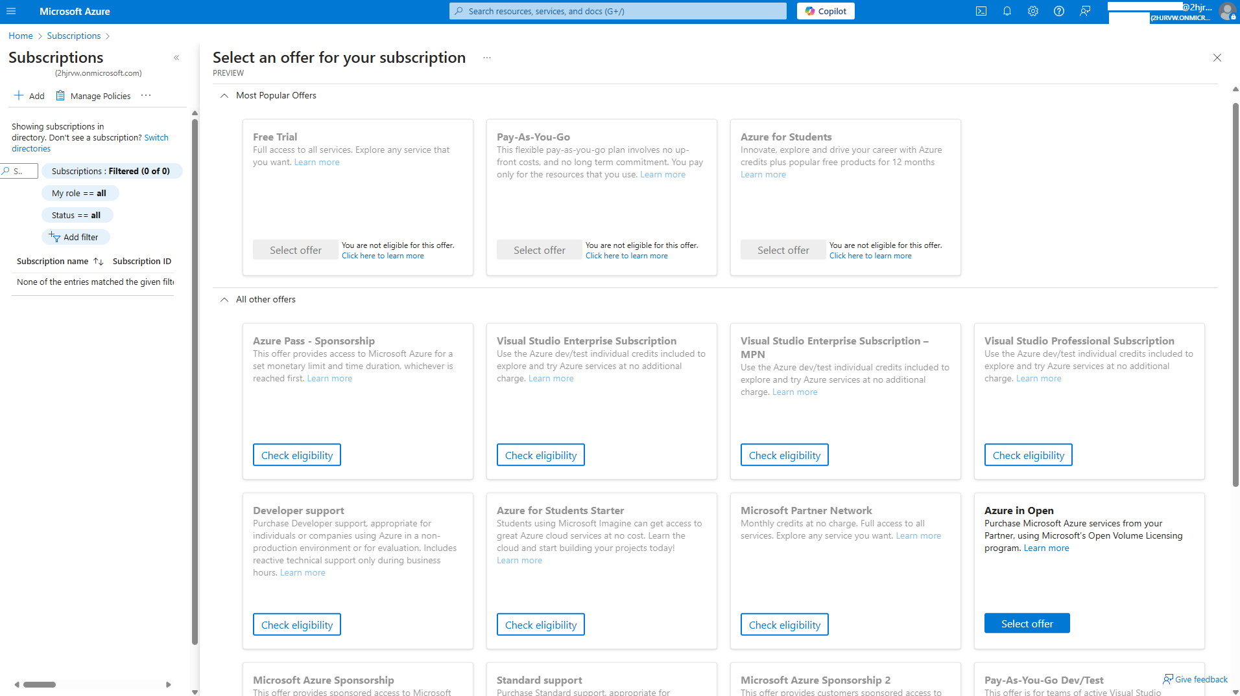
PROBLEM: Environments / Tenants
My problem persists in my ’DEV’ Environment:
I still haven't been able to activate a subscription. Does anyone know why? Why is almost every option on the add subscription page grayed out and deactivated, and the only way to get there is a dead end, I've already tried that. What could be the reason why I can't create a Free Trial Azure Subscription?

Slide 6
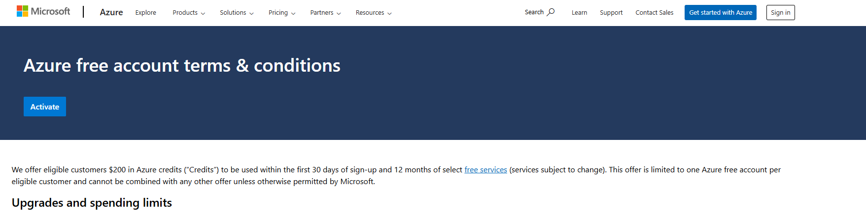
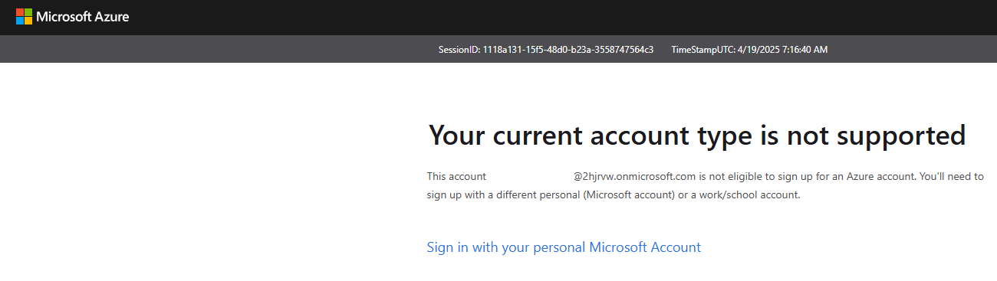
PROBLEM: Environments / Tenants
My problem persists in my ’DEV’ Environment:
If I tried to activate for example the Free Trial, than I got the following error message:

Slide 7
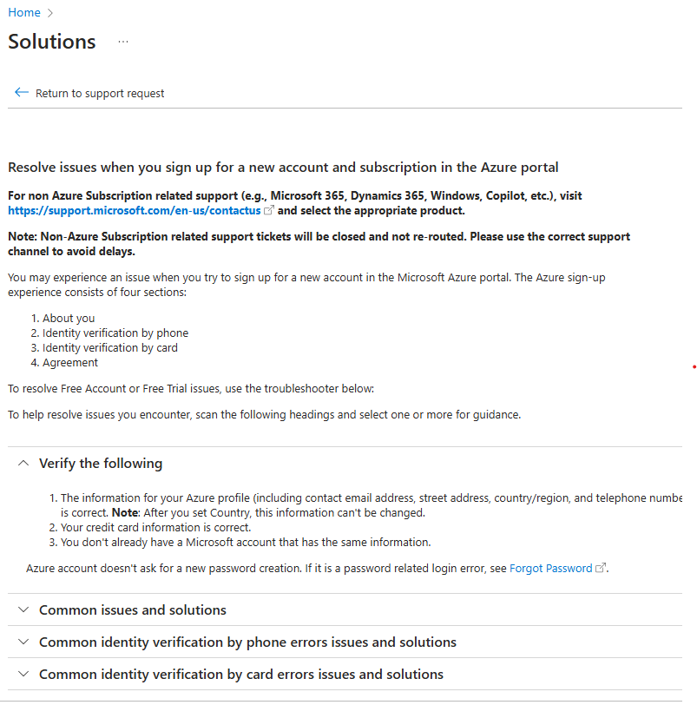
PROBLEM: Environments / Tenants
My problem persists in my ’DEV’ Environment:
If it technicalli possible i will have the willed Azure Subcription, however I try to report my Problem for MS Support, I receive the following error message:
Could you please help me figure out what I'm doing wrong?

Slide 8
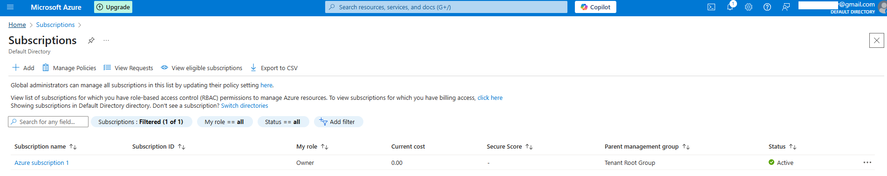
PROBLEM: Environments / Tenants
My workaround
My cut over for this problem was that, I created another free trial Azure using one of my not yet allocated email addresses:

Slide 9
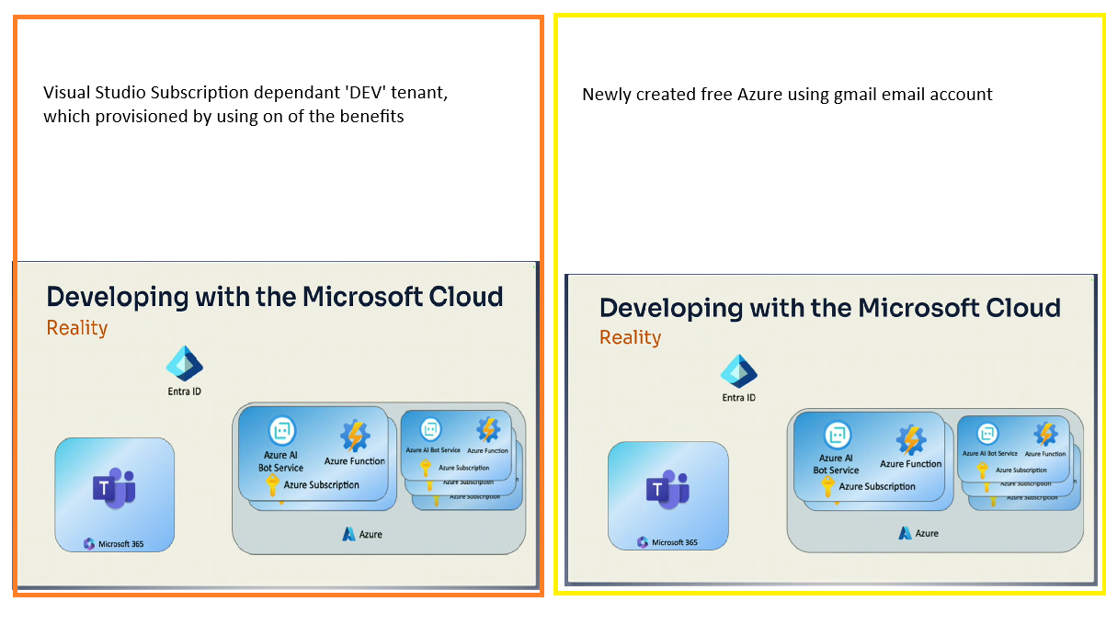
PROBLEM: Environments / Tenants
My workaround
The resulting construction is
technically not bad, but it
still didn't come together
the way I like it:
Do you Andrew have any idea
how to provision the red
marked area? Why all the
options on the
Add Subscription page are
disabled?

Slide 10
PROBLEM: Developer Machine
  I am using a physical laptop.
  The big problem is that I am using Windows OP and not Mac like you Andrew ☺
  The sutuation is getting worser if I tell you that I must use a Company givven setup. In this case I am logged in as a normal user and if I need running a program with higer rights I have to start progam as administrator and giving the credentials of my admin user (this is not the same which I use in usual).
  Because of this composition, I had already realized earlier, the folloving developer tools are not correctly installed / or are usabele:
    nvm (this was installed originall for SPFx development) -> therefore mpn na not setted up correctly (nvm install, and nvm use commands setting this program exclusively for the admin user and not for the normal)
  Let's focus on MS Teams development purposes.

Slide 11
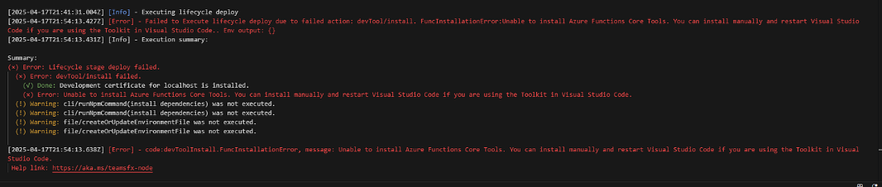
PROBLEM: Developer Machine
  As I write on the previous slide, I saw and realized in some cases Programs are not installed as I like.
  The problem I reported next related for the Visual Studio Code and for the Teams Toolkit itself:
  You written me, I have to think on a problem in the toolchain which hast to be installed by the Visual Studio Code extension the TTK. I got the idea, this can be related for my complex situation regarding my local user permission. Therefore I switched to the private Windows 11 operating system and laptop.

Slide 12
PROBLEM: Developer Machine
My 2nd workaround was,
using my own computer and creating a local user added this user to the Local Administrators group, and started the Visual Studio Code with Administrator rights.
This helped me to start the project, „buid” and publish the app.
Sadly, the command: „func -c” is not available in the problematic case, where you mentioned to use it.
Do you think we have any real chance to setting up the MS Teams development on the corporate developer machine and setup too the Visual Studio Code under the not admin (normal) and domain joined account and setup?
Maybe I only have to install first the 5 necessary tools in the app packaging chain, is this possible?
Before I start packaging and publishing the app.

Slide 13
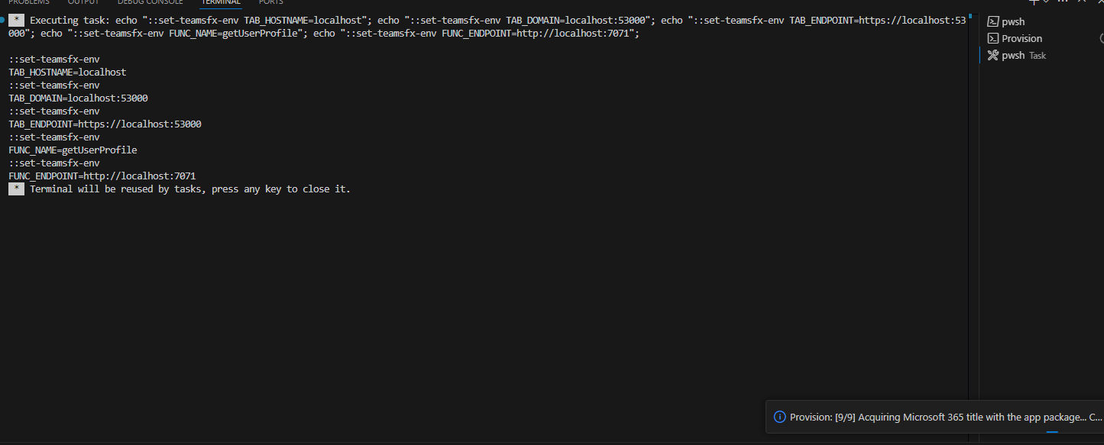
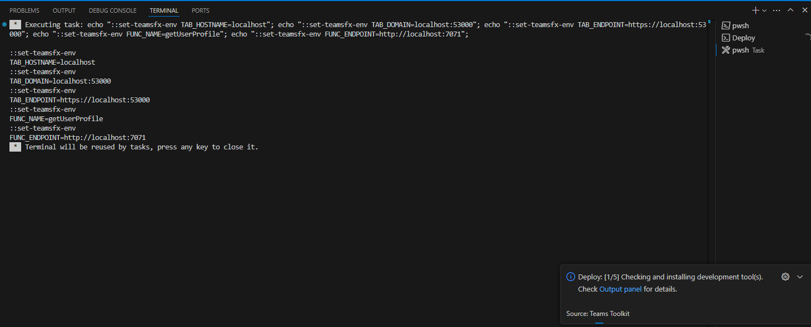
PROBLEM: D…
My 2nd workaround:
In the „Run” menu using
start with or without
debugging
components prepared well
components not installed

